Slide 1
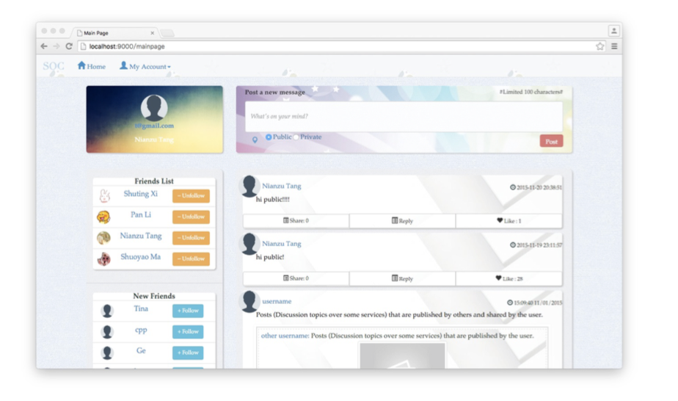
Project Title Project 2 : Zetwork
Point of contact - Faculty Advisor – Jia Zhang Team – Shuting Xi, Pan Li, Nianzu Tang, Shuoyao Ma
Service Oriented Computing (18-655), Fall 2015

Slide 2
Agenda Today
Introduction
Motivation
Related work
System design
System implementation
Demo
Conclusions and future work

Slide 3
ZetWork
Introduction: Social Net Work for Researcher

Slide 4

ZetWork
Motivation
Idea of “Twitter” within the company
Micro-blogging better suited to group

Slide 5

ZetWork
Related work
Based on the Apache project
Utilize the User model controller framework

Slide 6
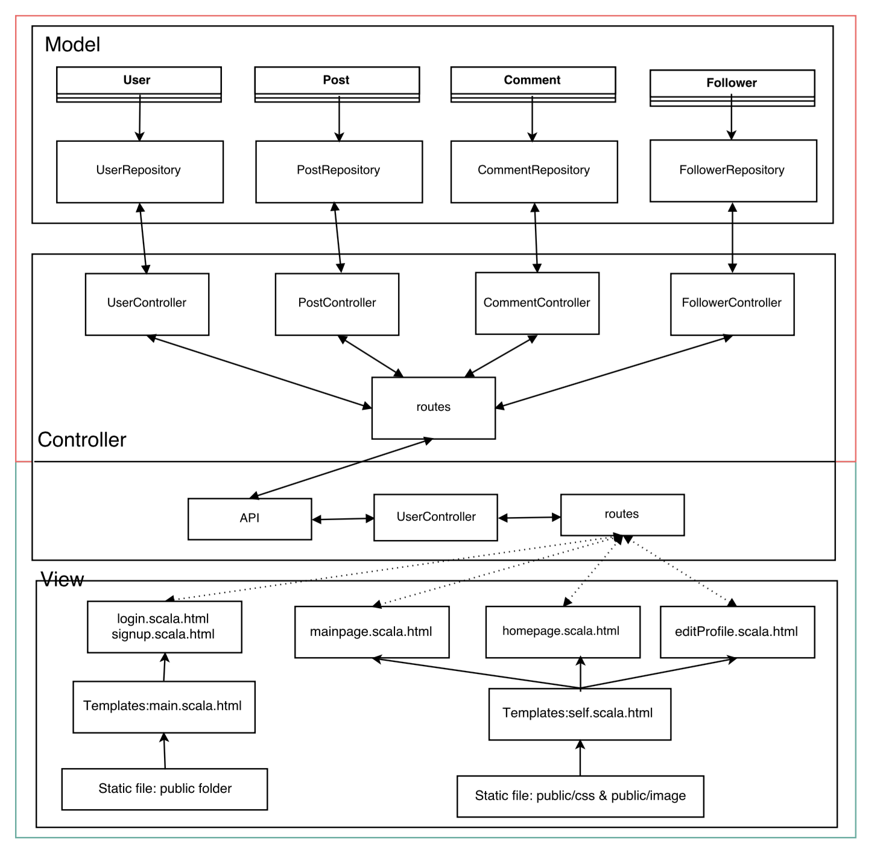
ZetWork
System Design: Overview
Backend
Frontend

Slide 7
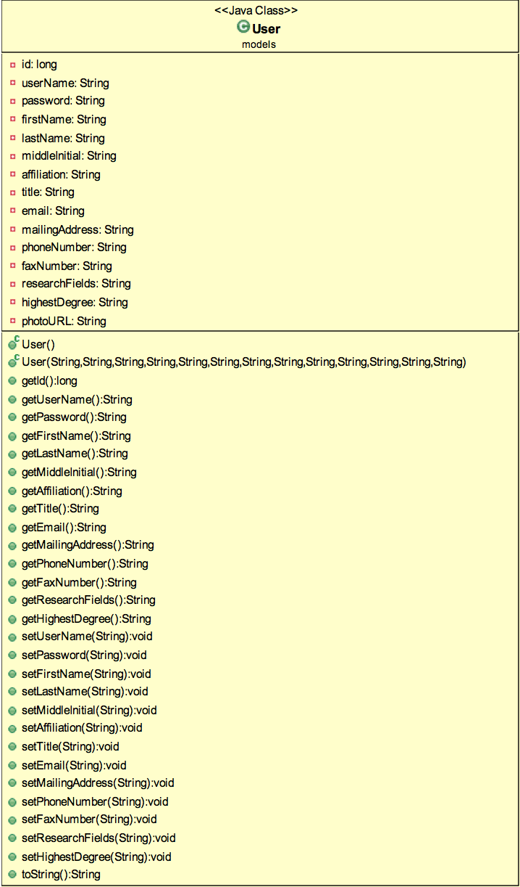
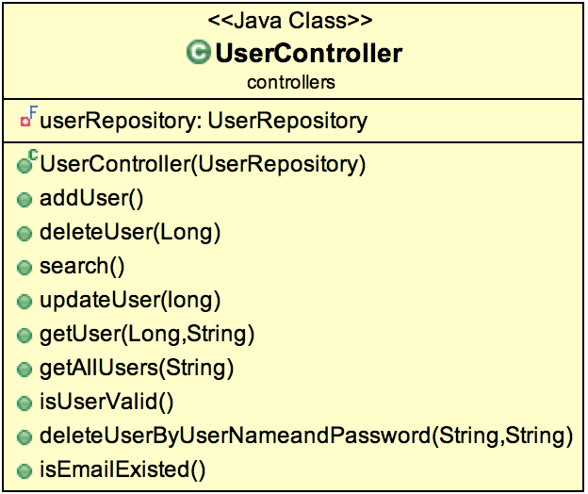
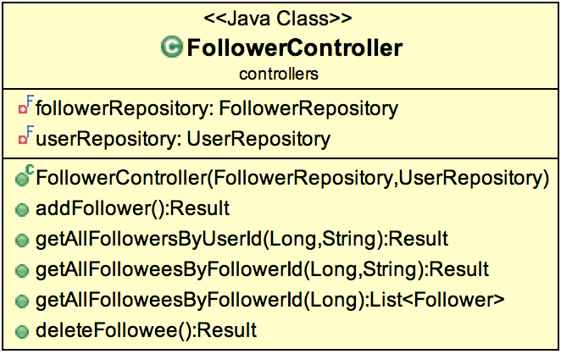
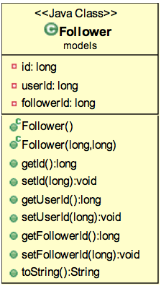
ZetWork
System design Backend Class UML Part 1:

Slide 8
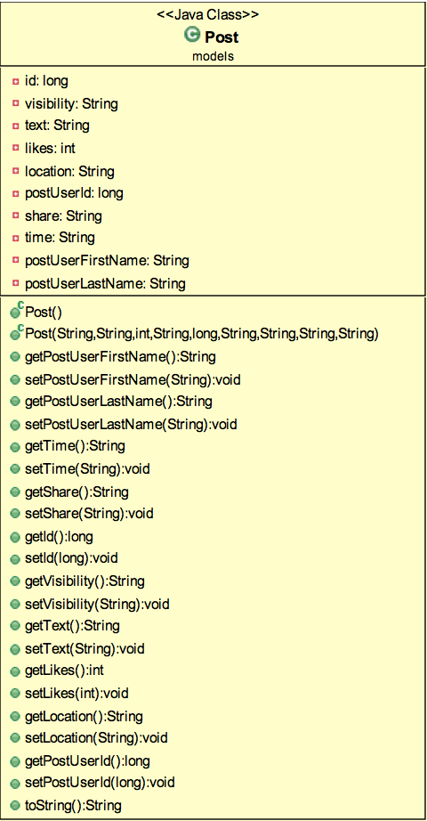
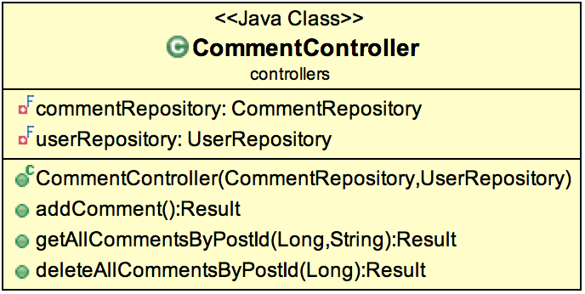
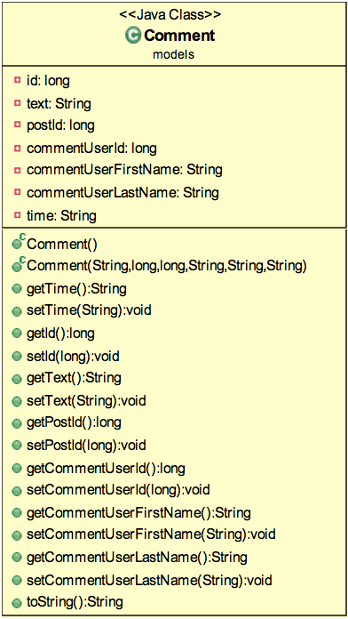
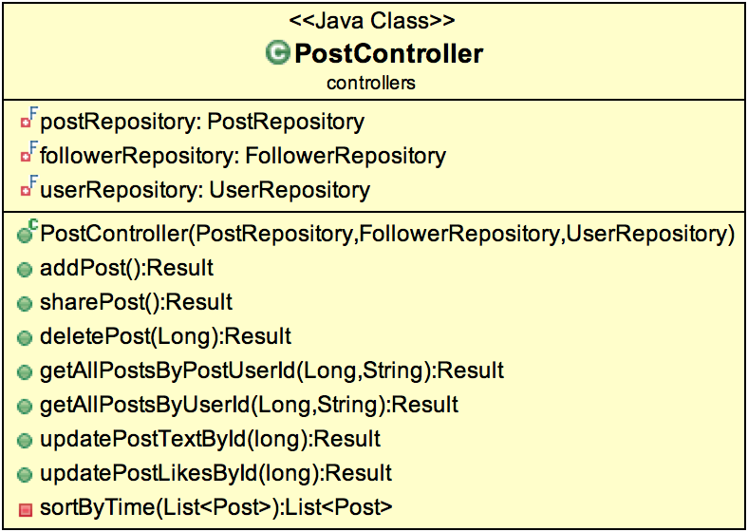
ZetWork
System design Backend Class UML Part 2:

Slide 9
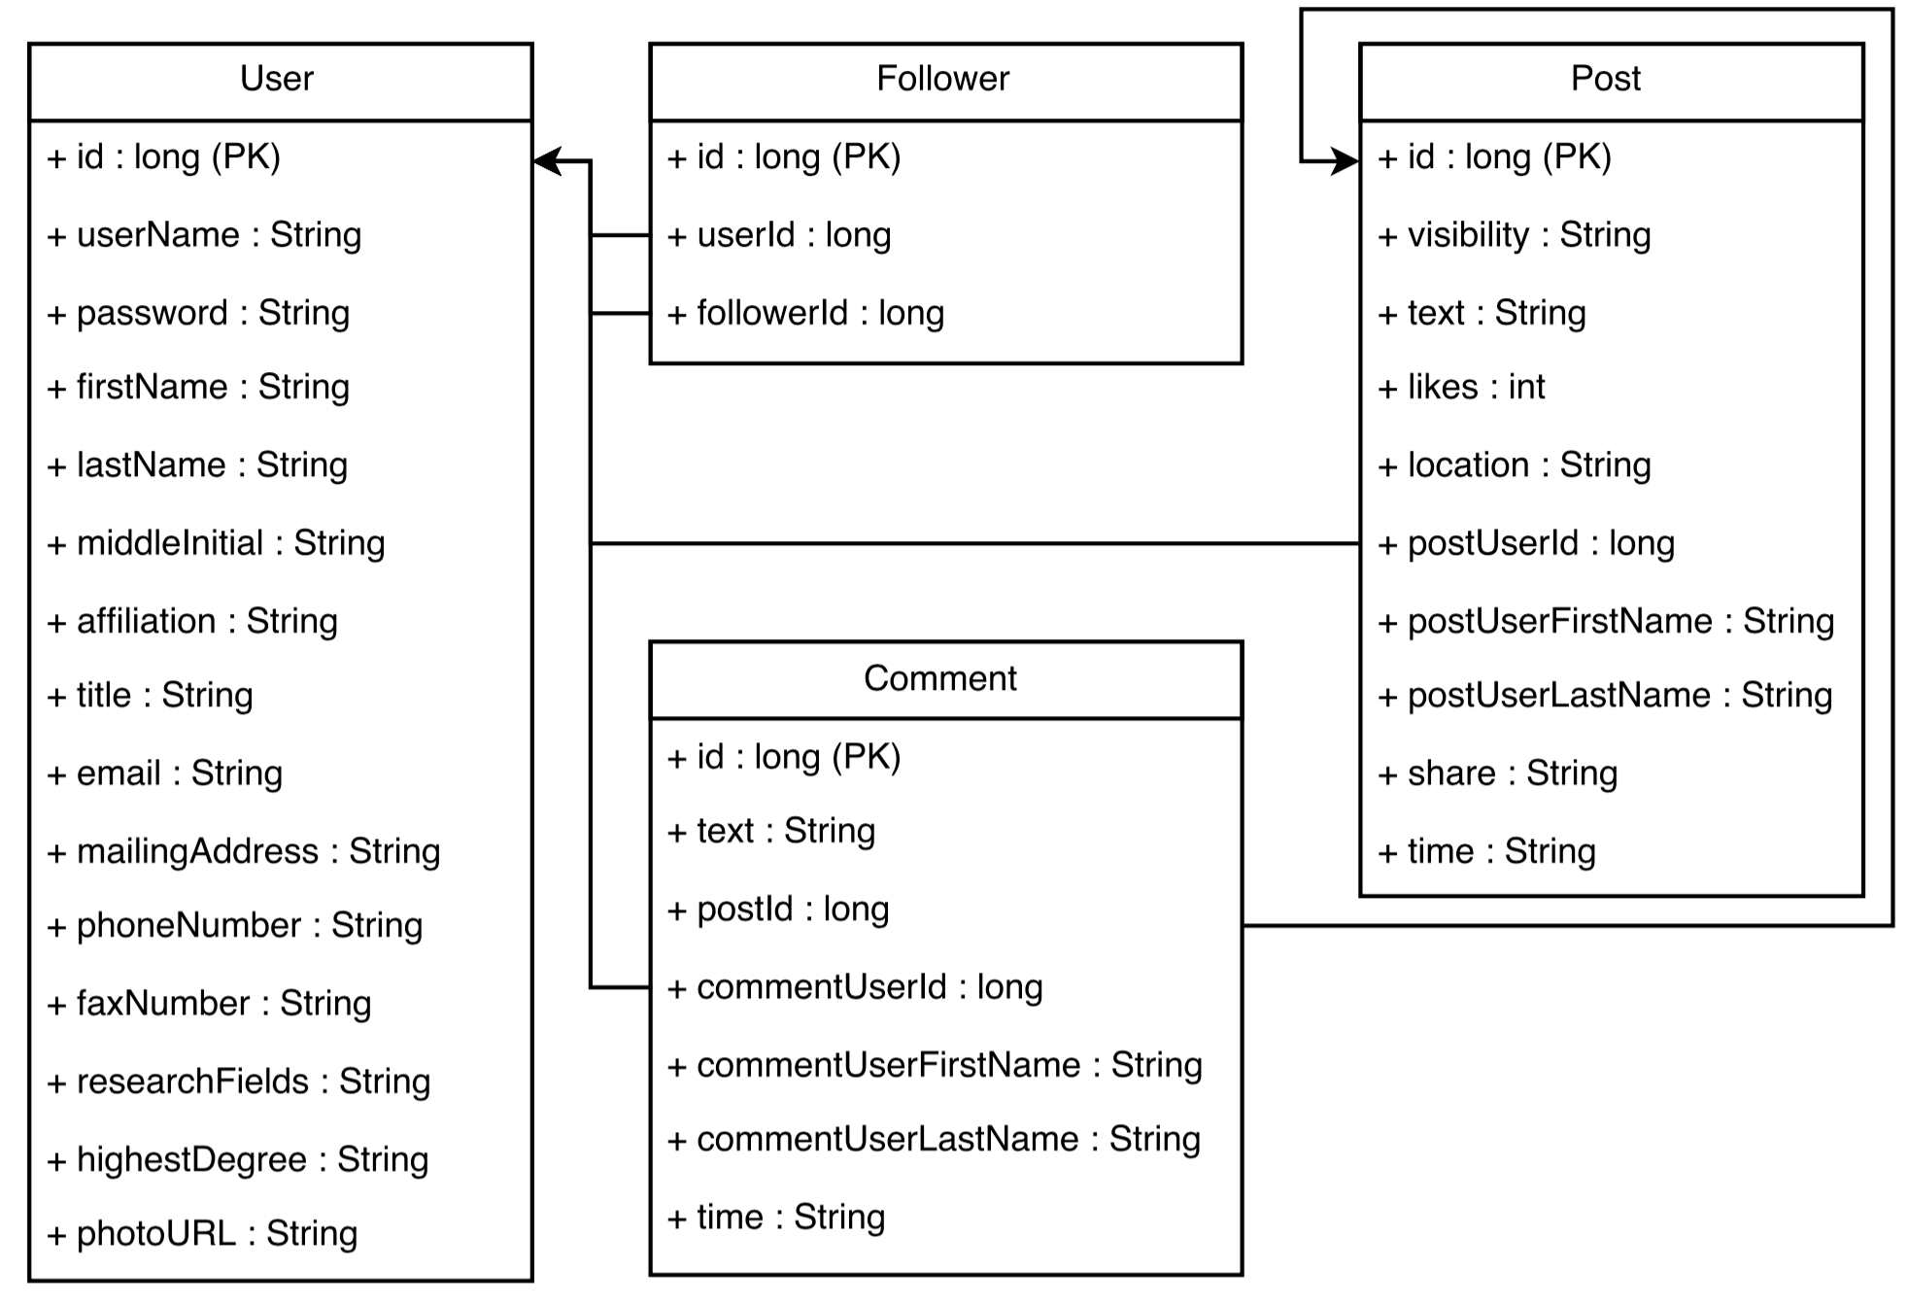
ZetWork
System design Backend Database Schema:

Slide 10
ZetWork
System implementation
Backend:
Language: Java
Database: MySQL
Frontend:
Web framework: Play Framework, HTML, CSS JavaScript, Bootstrap

Slide 11
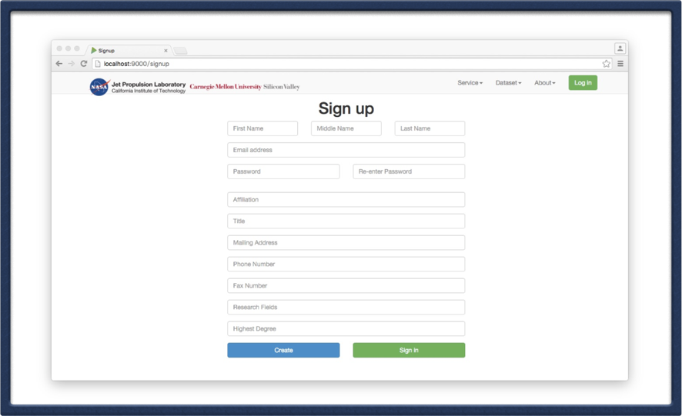
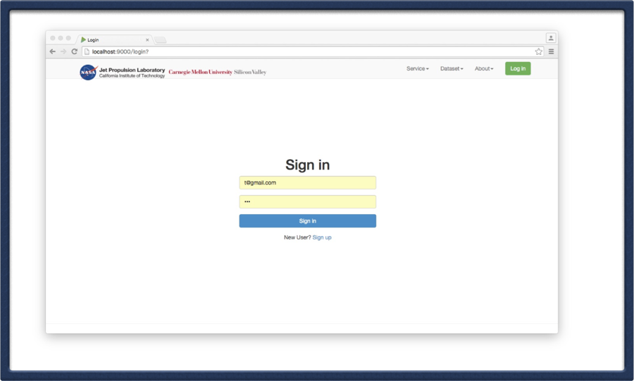
ZetWork
Demo
Sign In & Sign Up

Slide 12
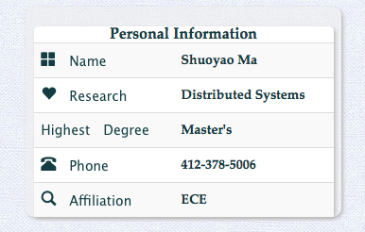
ZetWork
Demo: User Profile

Slide 13
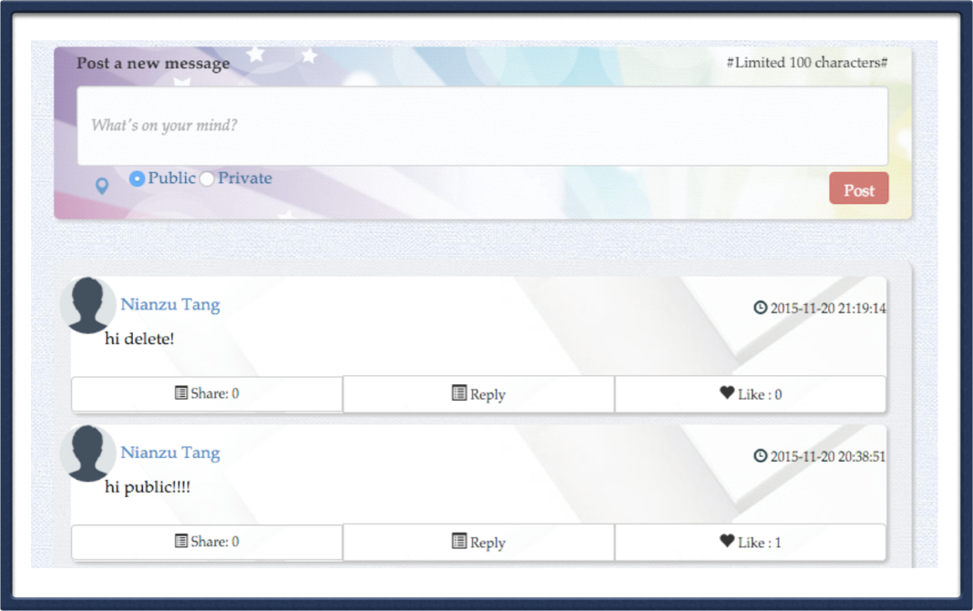
ZetWork
Demo: Post

Slide 14
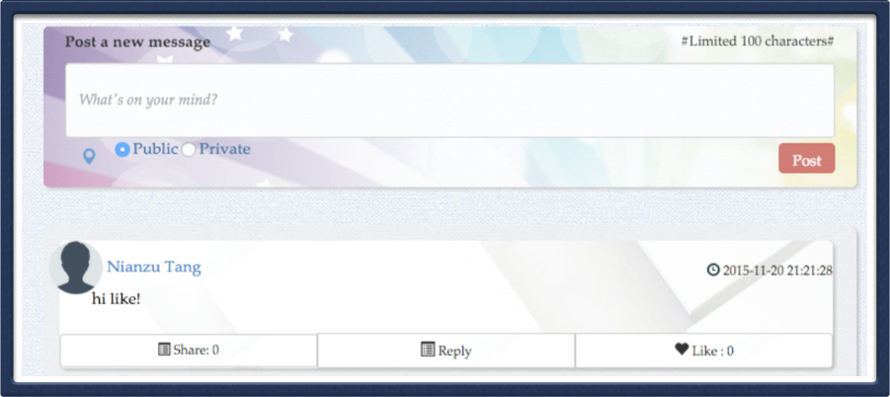
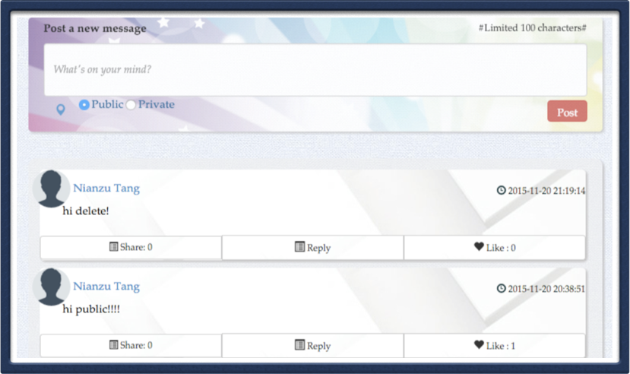
ZetWork
Demo: Delete & Like Post

Slide 15
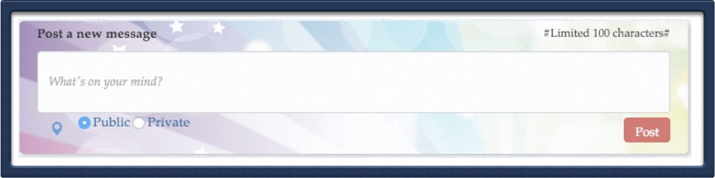
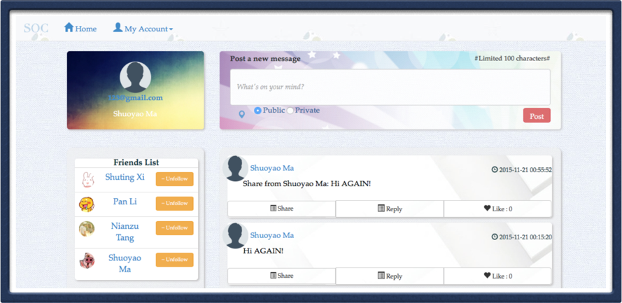
ZetWork
Demo: Set public & private Post

Slide 16
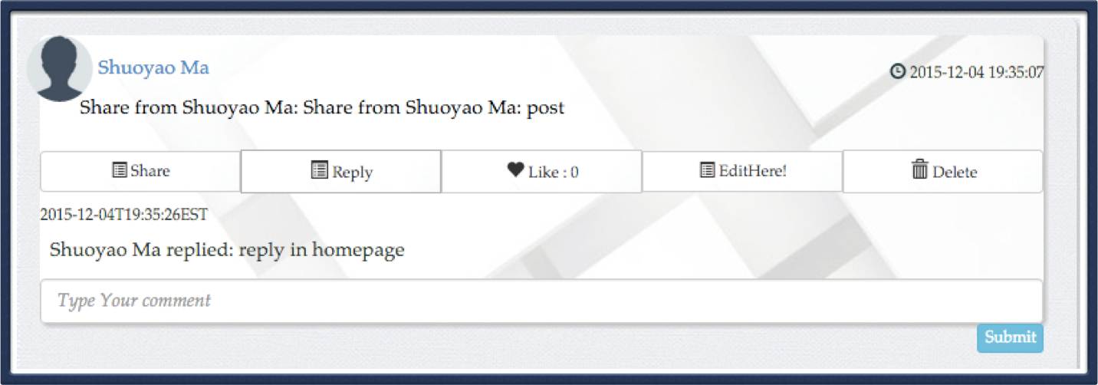
ZetWork
Demo: Comment

Slide 17
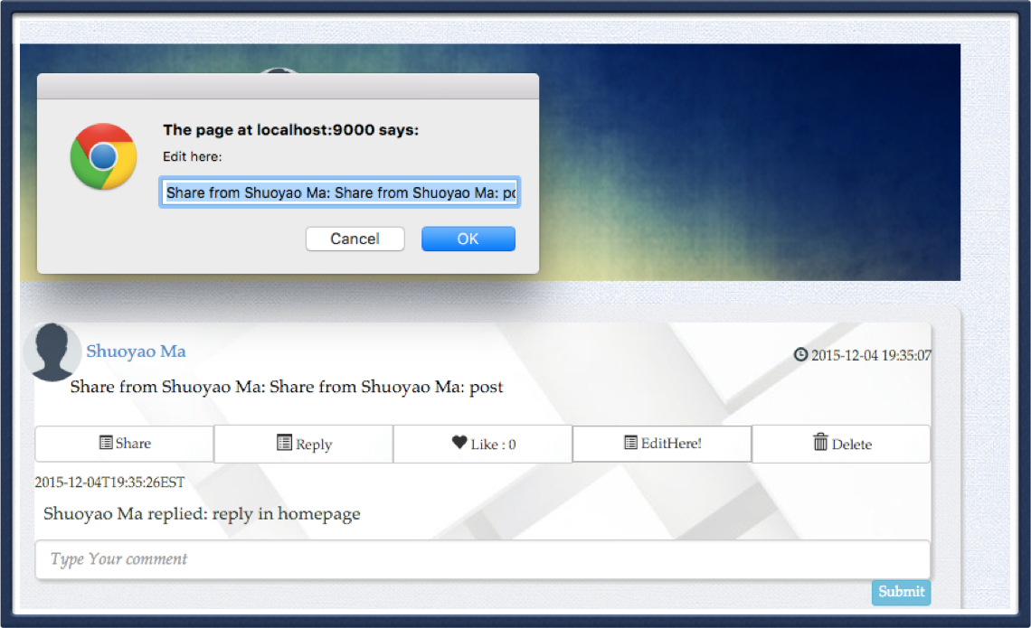
ZetWork
Demo: Edit Post

Slide 18
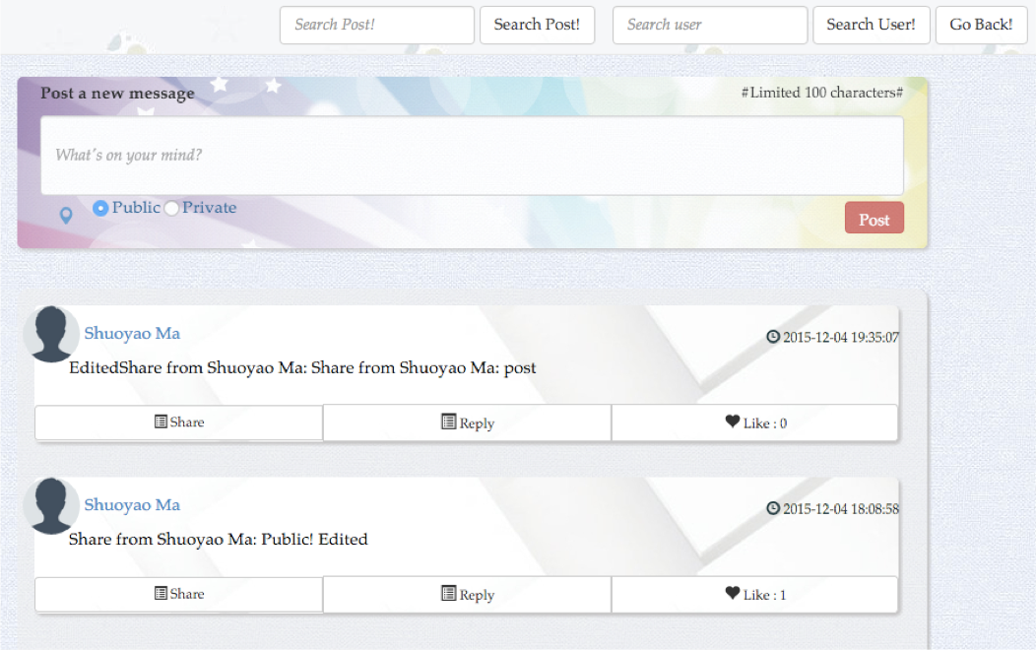
ZetWork
Demo: Search Post

Slide 19
ZetWork
Demo: Search Post

Slide 20
ZetWork
Demo: Search Post

Slide 21
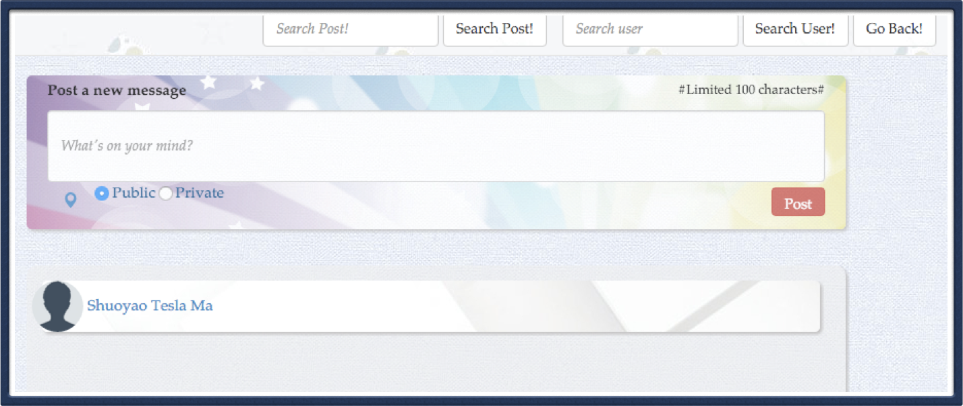
ZetWork
Demo: Search User

Slide 22
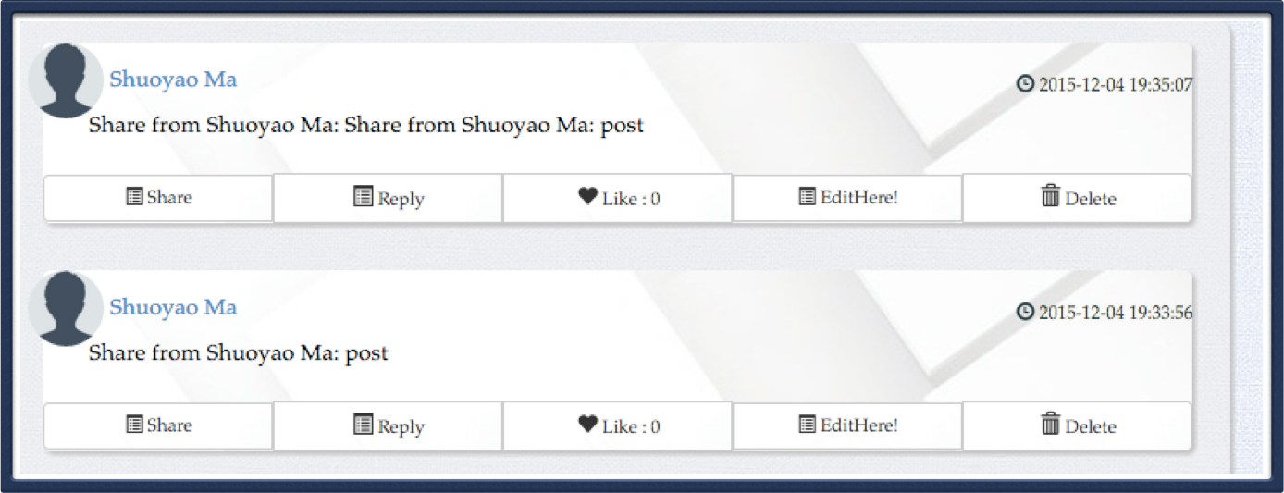
ZetWork
Demo: Share

Slide 23
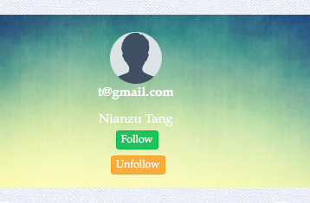
ZetWork
Demo: Follow

Slide 24
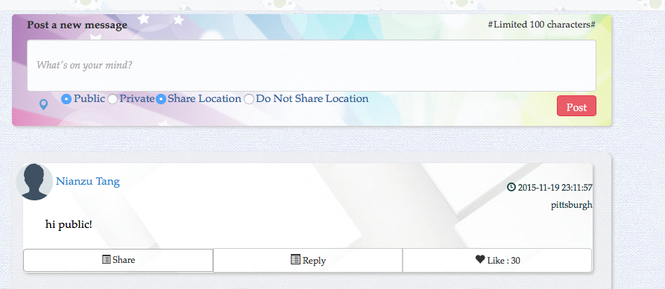
ZetWork
Demo: Location

Slide 25
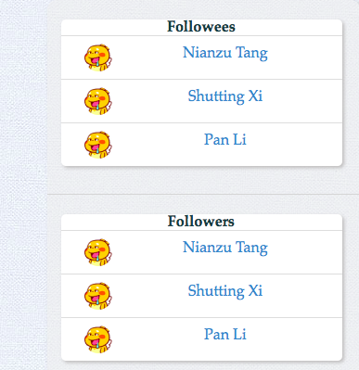
ZetWork
Demo: Optional Features: Unfollow

Slide 26
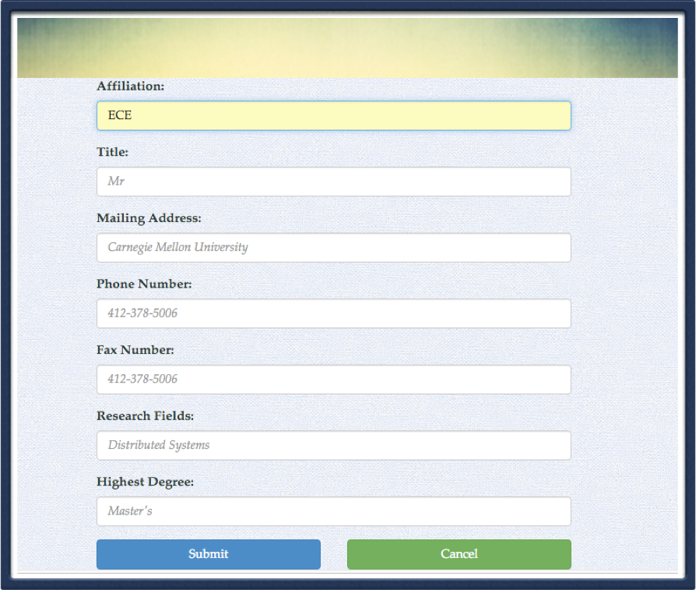
ZetWork
Demo: Optional Features: Edit User Profile

Slide 27
ZetWork
Conclusions and future work
Conclusion:
Implemented Social Network Features in this Project
Future Work:
I: Active Log Feature
II: Live Chatting Feature
III: Third Party Idetification

Slide 28

Questions?

